Slide 1

The Social Pulse of MSFT Sentiment & Stocks
Unveiling the Relationship Between Reddit Sentiments and Market Movements
Ansam Zedan, Daniel Wullschleger
22.12. 2023

Slide 2


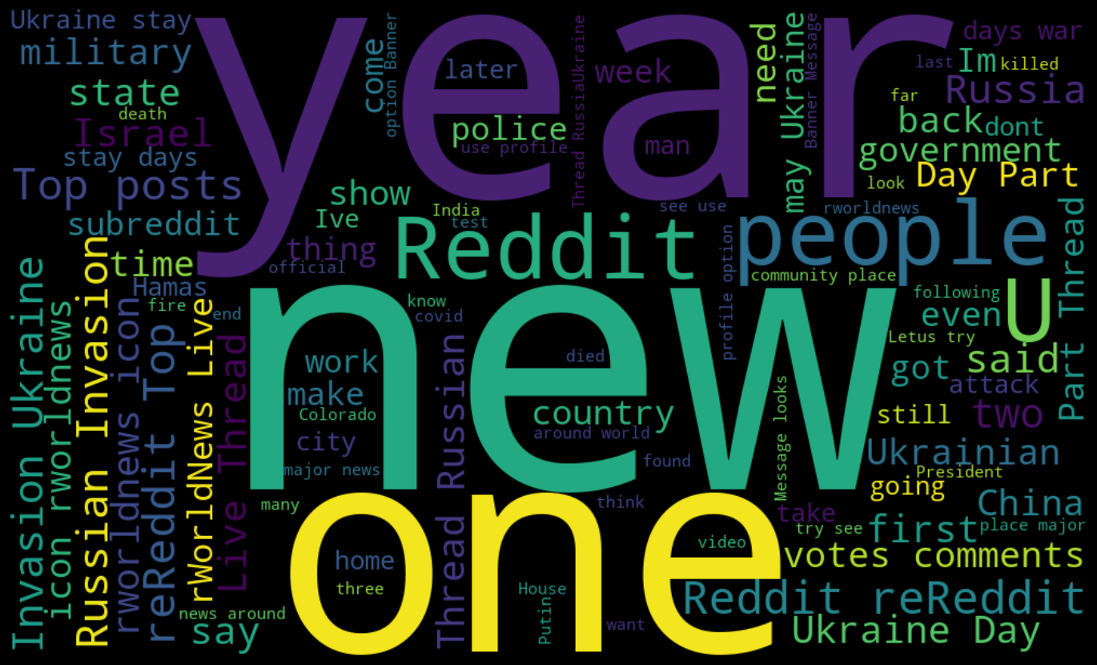
Project Overview
DATA
Webscraping for Reddit posts
Sentiment Analysis
Nltk, textblob libraries
VADER
EDA
Data Transformation
Future insights
Modeling
VAR - Vector Autoregression
Forecasting
Predictions
Conclusion
Conclusion
Auto.arima
Yahoo API for Stock data
Data Wrangling
Model evaluation
Another sentiment analysis
Seasonal Adjustment

Slide 3
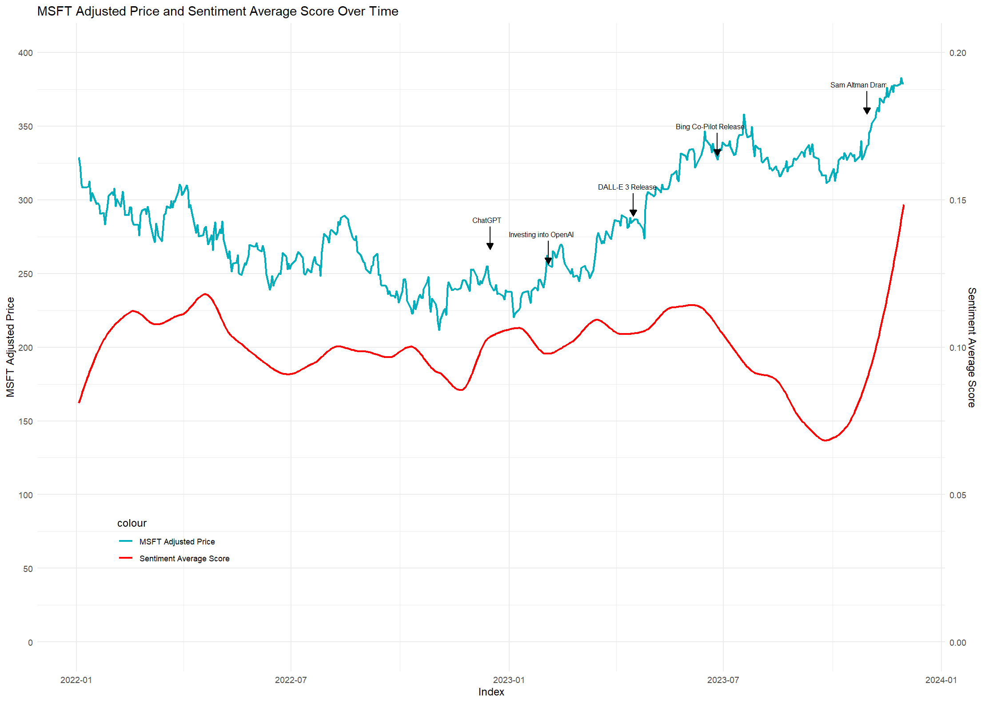
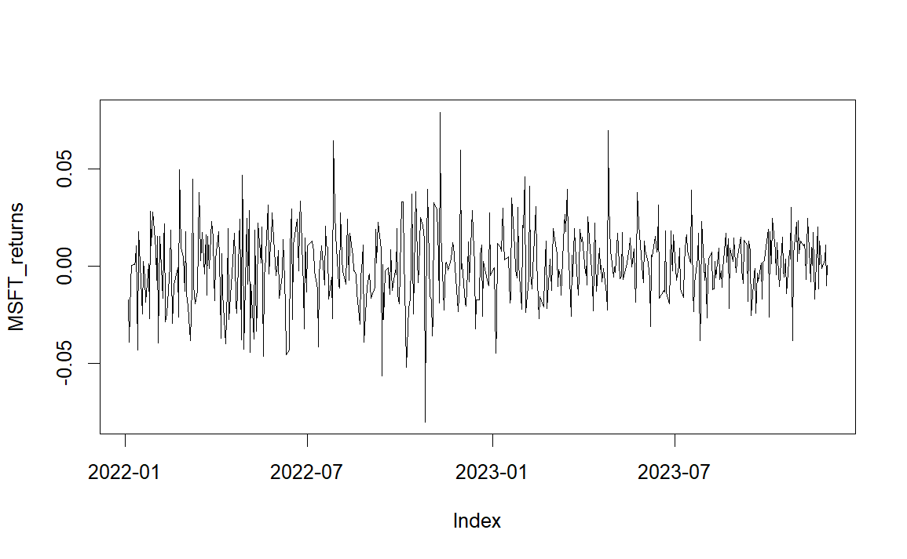
MSFT price vs Reddit Posts Sentiment
log-transform differencing

Slide 4
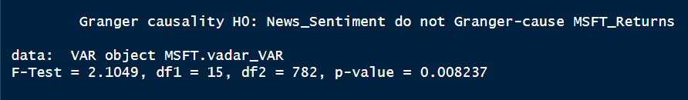
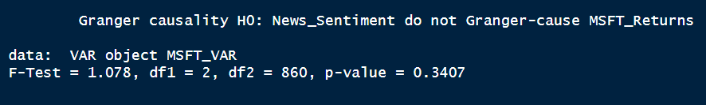
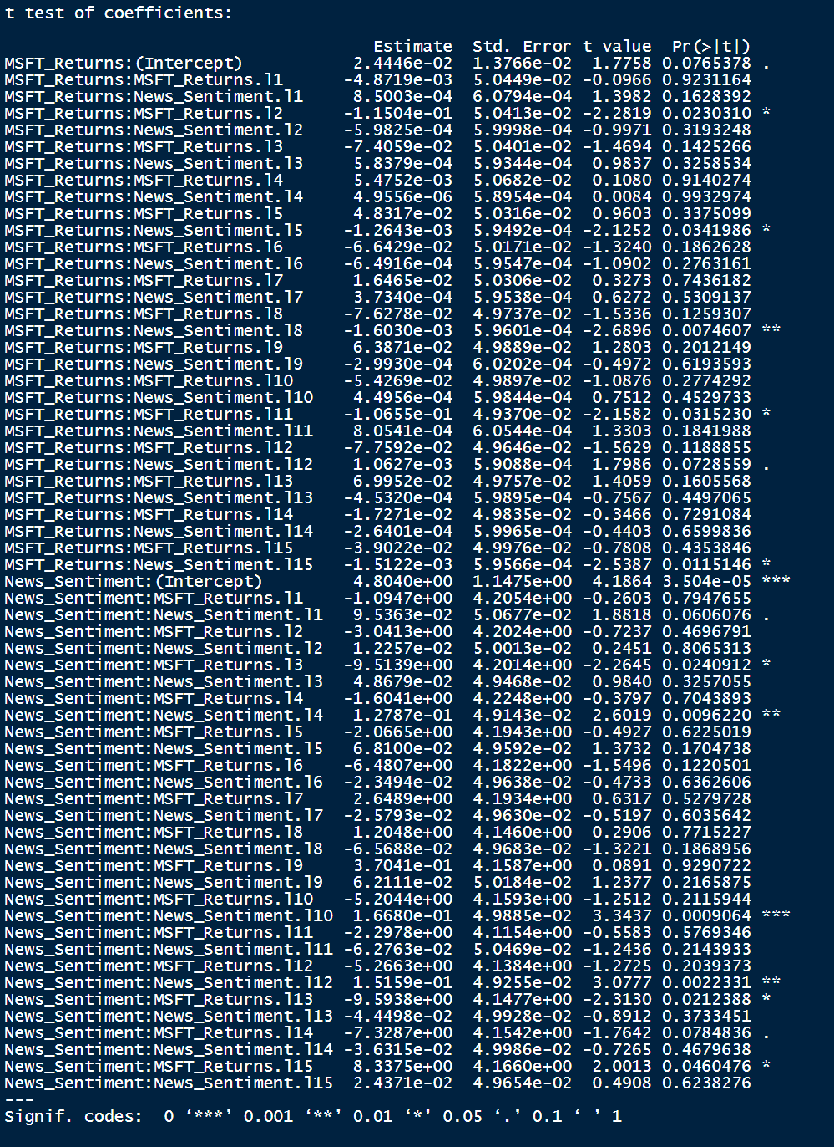

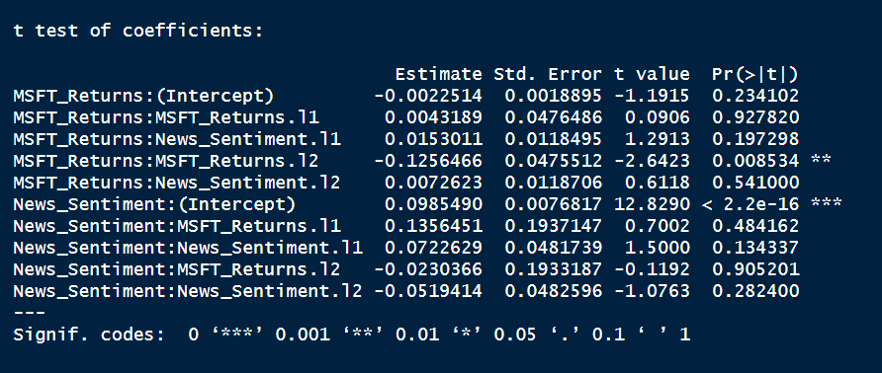
VAR Model on Sentiment Data
VADER sentiment
NLTK sentiment

Slide 5
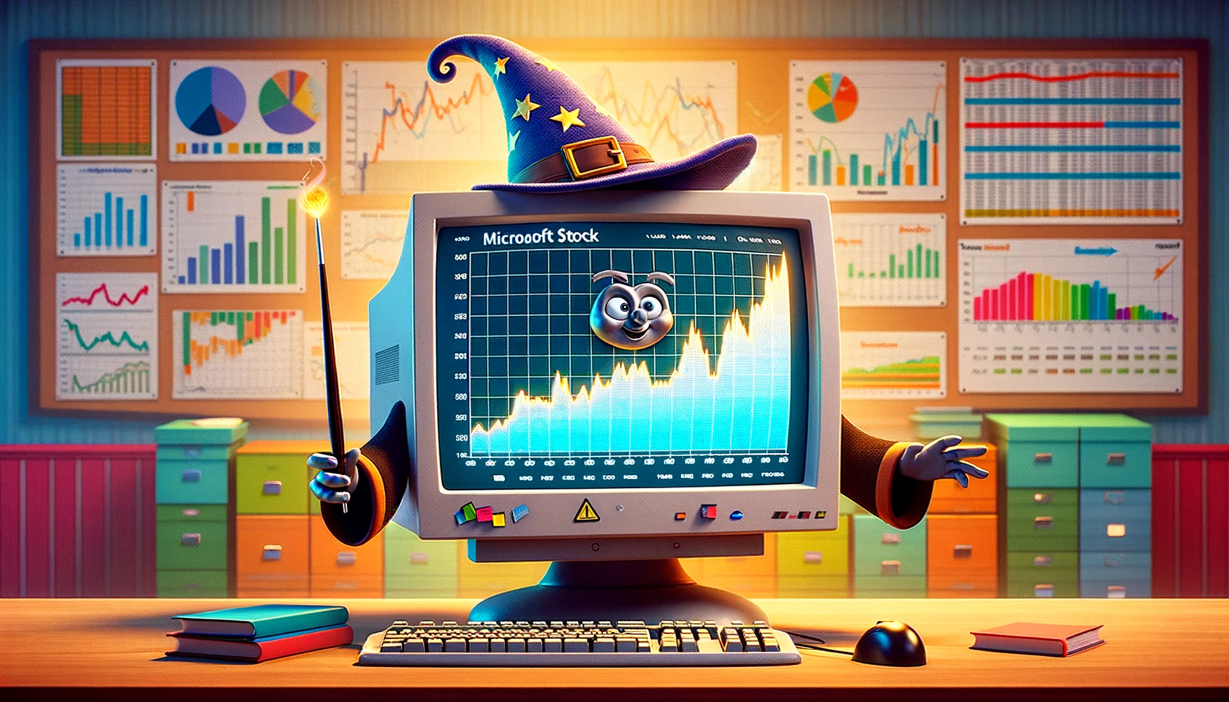
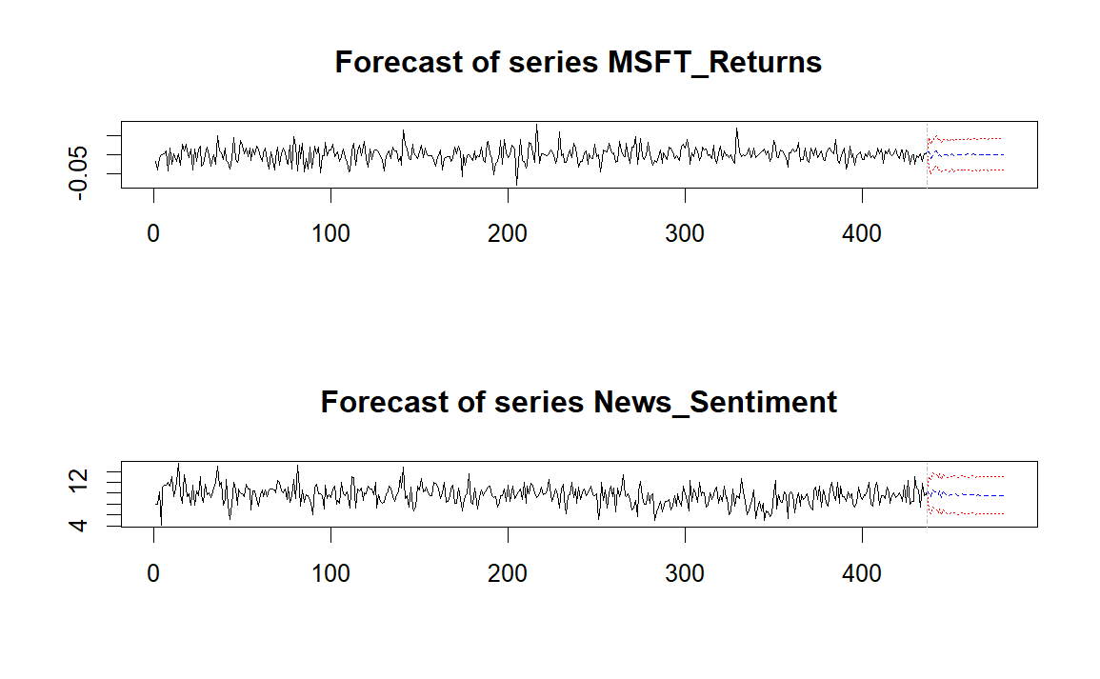
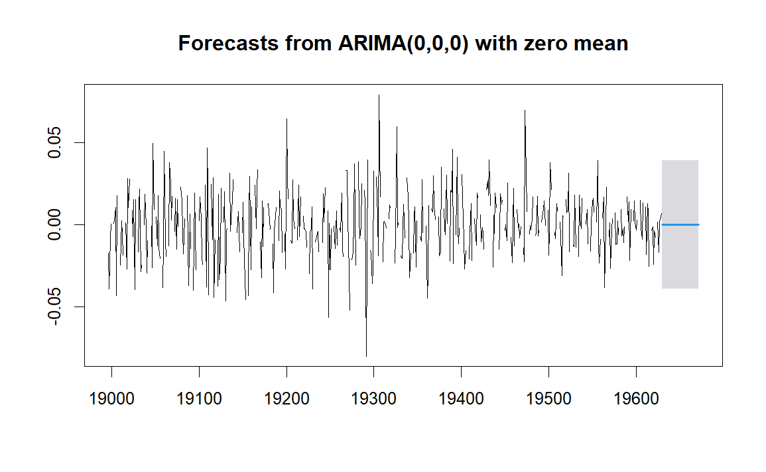
Forecasting
RMSE OF VAR
0.036
RMSE OF AR(2)
BENCHMARK
0.014

Slide 6
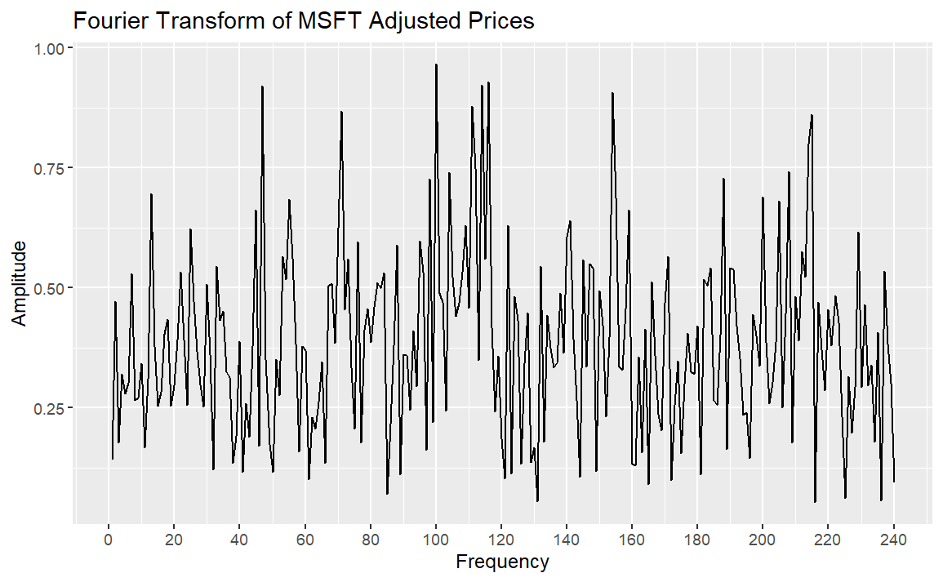
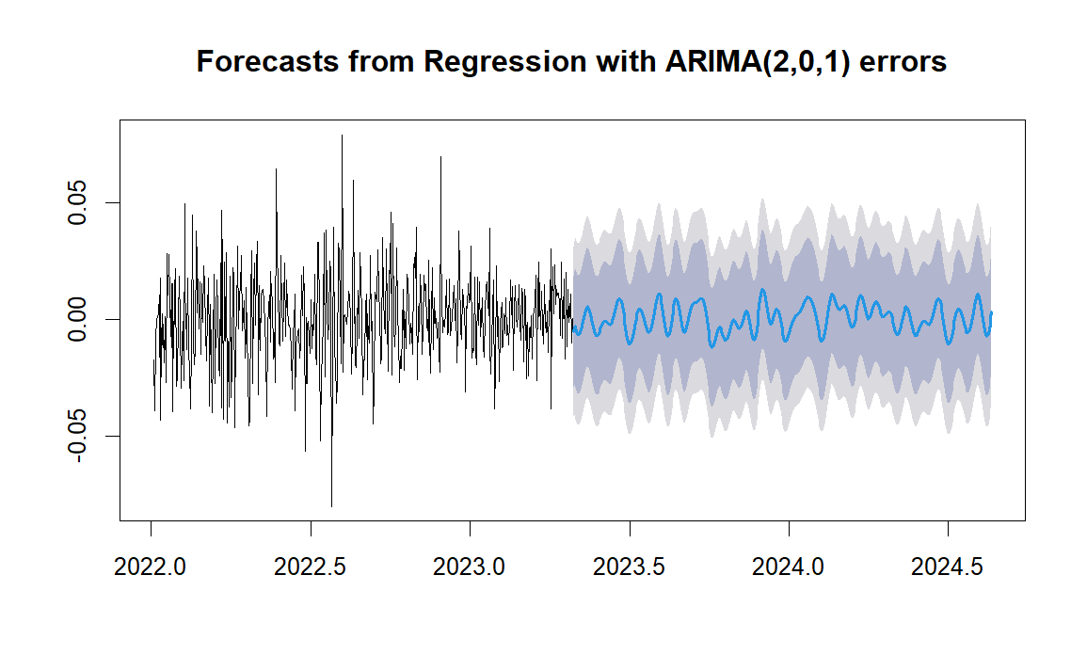

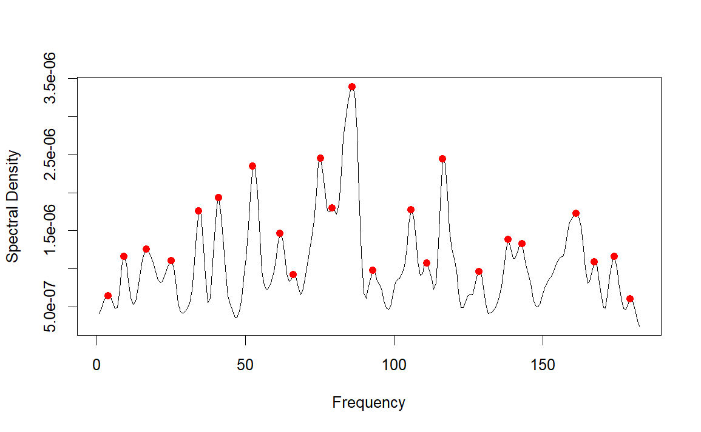
Seasonal Adjustment - Fourier Transform
RMSE
0.015

Slide 7

Conclusions
Importance of sentiment analysis model trained on social media.
Impact of news on the stock market.
Capturing seasonality in stock data.
Future Work
Consider other economic indicators.
Train on more data.
Add broader news sources.

Slide 8

Q&A

